Slide 1
Wideband Receiver Calibration using USRP X410
Nikhil Challa
Lund University

Slide 2
Modeling the Channel
Channel
Transmitter
X
H
Y
Receiver
Tx
Rx
Y(f) = Received Signal
H(f) = Channel Response
X(f) = Input/Reference Signal
α
Y(f) =
Rx(f) Tx(f)
H(f)
X(f)
Tx(f) = Transmitter Response
Rx(f) = Receiver Response
α = PLL Phase Lock
Hardware
Response
Notes:
Transmitter response and Receiver Response can expect to be the same provided we use the same frequency and near the same Transmit power
Alpha, on the other hand is fixed as long as the Transmitter and Receiver are

Slide 3
MIMO Wireless Systems
X1
Tx1
Rx1
Y1
X2
Tx2
Rx2
Y2
H
X3
Tx3
Rx3
Y3
X4
Tx4
Rx4
Y4

Slide 4
Combine hardware response with the channel response
What is possible?
Use reference signal to detect phase offset and apply correction to data signals
What is difficult?
Direction of Arrival (DoA) estimation
Matrix decomposition for MRC / Water pouring / channel estimation
Reuse of the same precoding matrix for another UE
Summary: OK for SISO systems, but sub-optimal for MIMO systems
Goal: Find a way to remove the hardware response
Notes:
Ok for SISO systems but not only for MIMO systems

Slide 5
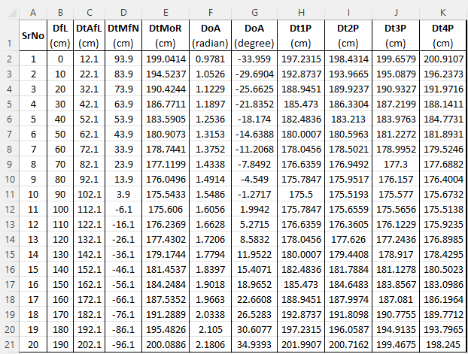
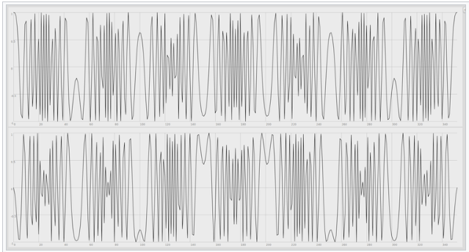
Extract out hardware response using SISO
Transmitter
Channel
Receiver
X
T
Wireless ⬄ Multipath
H
R
Y
Receiver Signal
ZC Sequence
Physical Measurements
Notes:
Easy but the catch is wireless systems
Zadoff Chu sequence : constant-amplitude output signal
very good auto-correlation property

Slide 6
Remove Multipath?
SAGE (Space-Alternating Generalized Expectation-maximization)
Separate out Multipath components
Iteratively subtract out different paths, starting with the strongest path (LoS)
Contains both hardware and channel response
Utilize Phase information from LoS component
X1
T1
R1
Y1
SAGE limitation: Relies on strong LoS component!

Slide 7
Step 1: Planning / Setup Requirement
Strong LoS
Fresnel Zone Clearance
DoA Estimation
Confidence in calibration results
Multiple points of Tx Location
Verify estimated DoA with ground truth
Far Field Approximation
Notes:
(first Fresnel Zone) Radius around LoS contains no obstructions or reflecting surfaces
Distance (Rayleigh distance) between Tx and Rx to approximate radiation pattern to planar wavefront

Slide 8
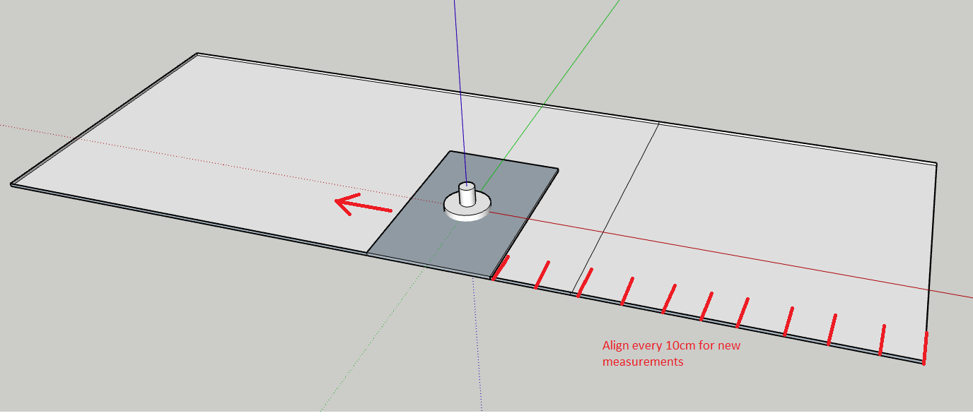
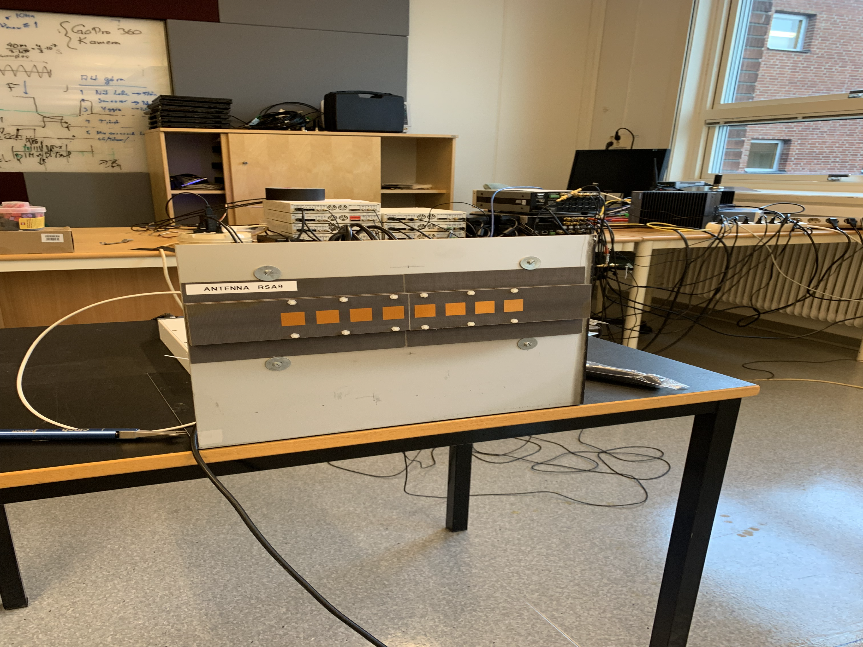
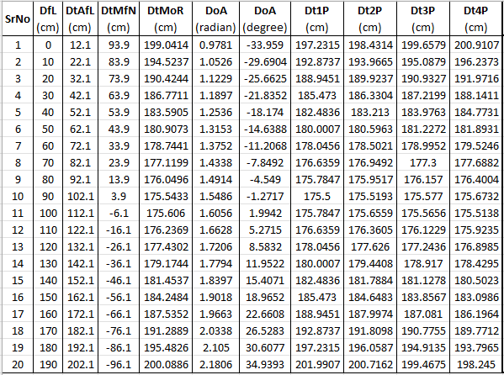
Step 2 : Data Collection
First Fresnel Zone Radius + Rayleigh Distance
Consider multiple points of Tx Location
Estimate DOA and verify with ground truth

Slide 9
Step 3 : Frequency Error Correction

Slide 10
Step 4 : Stable stationary point selection
KNN Clustering with bad sample removal
Two inputs:
Number of stable points
% of time in stationary position
Collect consecutive samples (window)
Cluster windows based on the mean
Remove bad windows based on variance
Notes:
Notice that this is unwrapped phase

Slide 11
Step 5 : Unwrapped phase error removal
Outlier detection using information from all receivers

Slide 12
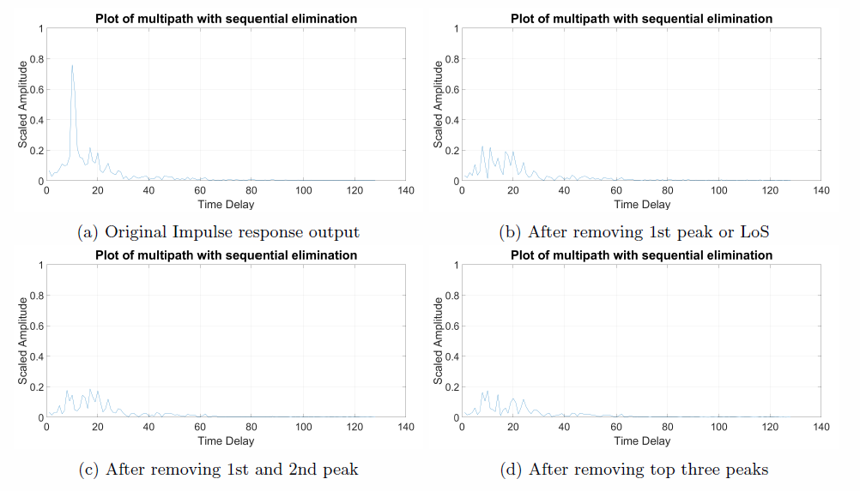
Step 6 : LoS Separation
Notes:
Slight anomaly is because of uncertainty in the unwrapped phase as we are too close to 2pi shift – Will cover towards the end on improvements

Slide 13
Step 7 : Verifying B2B Meas Data reliability

Slide 14
Step 8 : Calibration Data

Slide 15
Step 9 : Calibration data reliability
Notes:
Ignore all the lines except the blue line, straight line in middle, and the red line
A possible suspect is the table was not exactly parallel to the patch antenna. While calculating LoS distance using physical measurements, we didn’t take Tx to Rx directly

Slide 16
Room for Improvements
Limit min and max phase difference between adjacent Tx positions
Include the exact mid-Tx position
Mathematically friendly numbers
Selecting Rx antennas with larger separation
Ensure the Tx antenna moves exactly parallel to the patch antenna alignment

Slide 17
Conclusion
Hardware response can be reliably extracted using discussed methods
Channel response can then be estimated reliably using hardware response
Performance of MIMO systems can be improved

Slide 18
Thank you

